Slide 1
COMP10001
Hi everyone! We’ll start the tutorial at 4:15 :)
Draw a little picture of yourself on this slide using the zoom annotate buttons!
Tutorial 1

Slide 2
A little bit about me!
Took COMP10001 in 2016

Slide 3
A little bit about me!
Took COMP10001 in 2016
Graduated BSc in 2018
Graduated Master of Computational Biology in 2020

Slide 4
A little bit about me!
Took COMP10001 in 2016
Graduated BSc in 2018
Graduated Master of Computational Biology in 2020
Now working on a PhD in the School of Maths and Stats
Geospatial modelling of mosquito-borne diseases:
Zoonotic malaria, drug-resistant malaria, Japanese encephalitis
Structured spatial decision making:
Where should we concentrate resources given the things we know about disease risk?

Slide 5
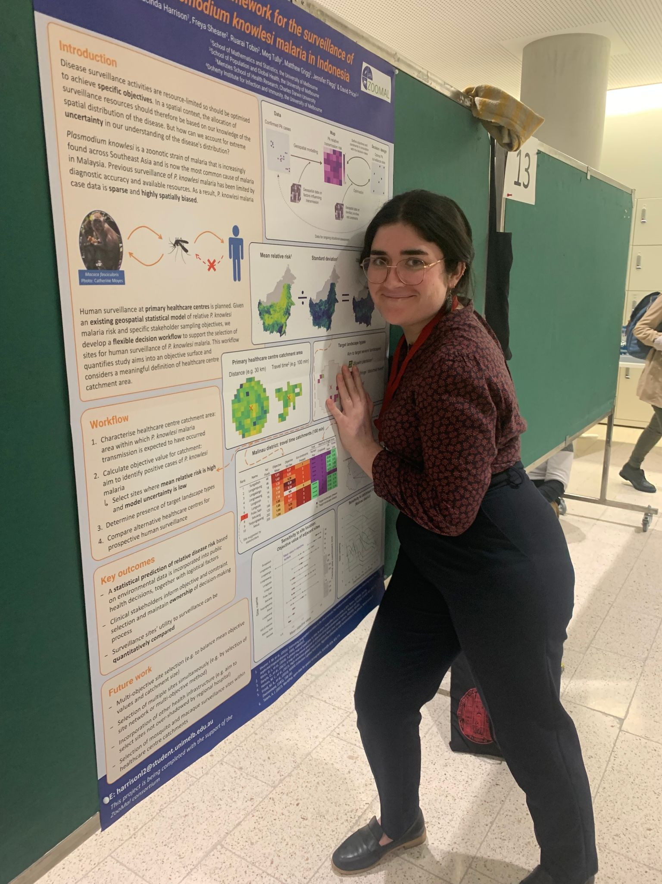
A little bit about me!
Took COMP10001 in 2016
Graduated BSc in 2018
Graduated Master of Computational Biology in 2020
Now working on a PhD in the School of Maths and Stats
Geospatial modelling of mosquito-borne diseases:
Zoonotic malaria, drug-resistant malaria, Japanese encephalitis
Structured spatial decision making:
Where should we concentrate resources given the things we know about disease risk?

Slide 6
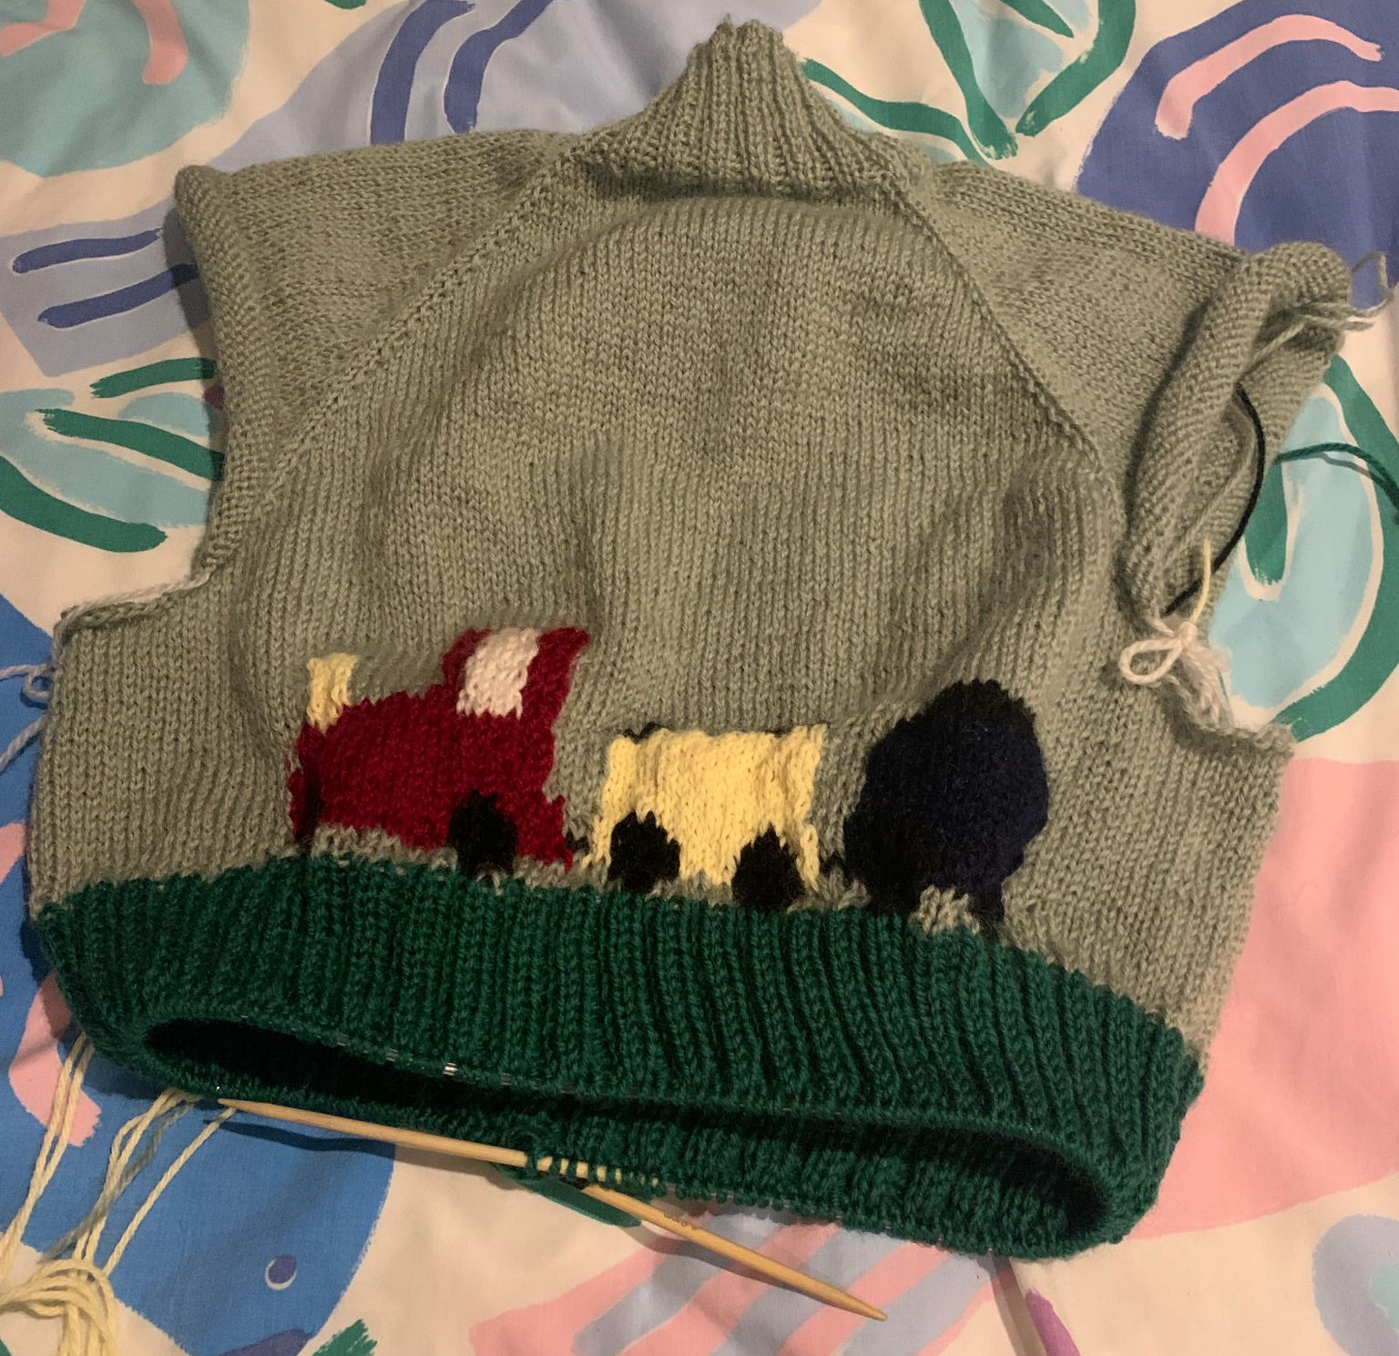
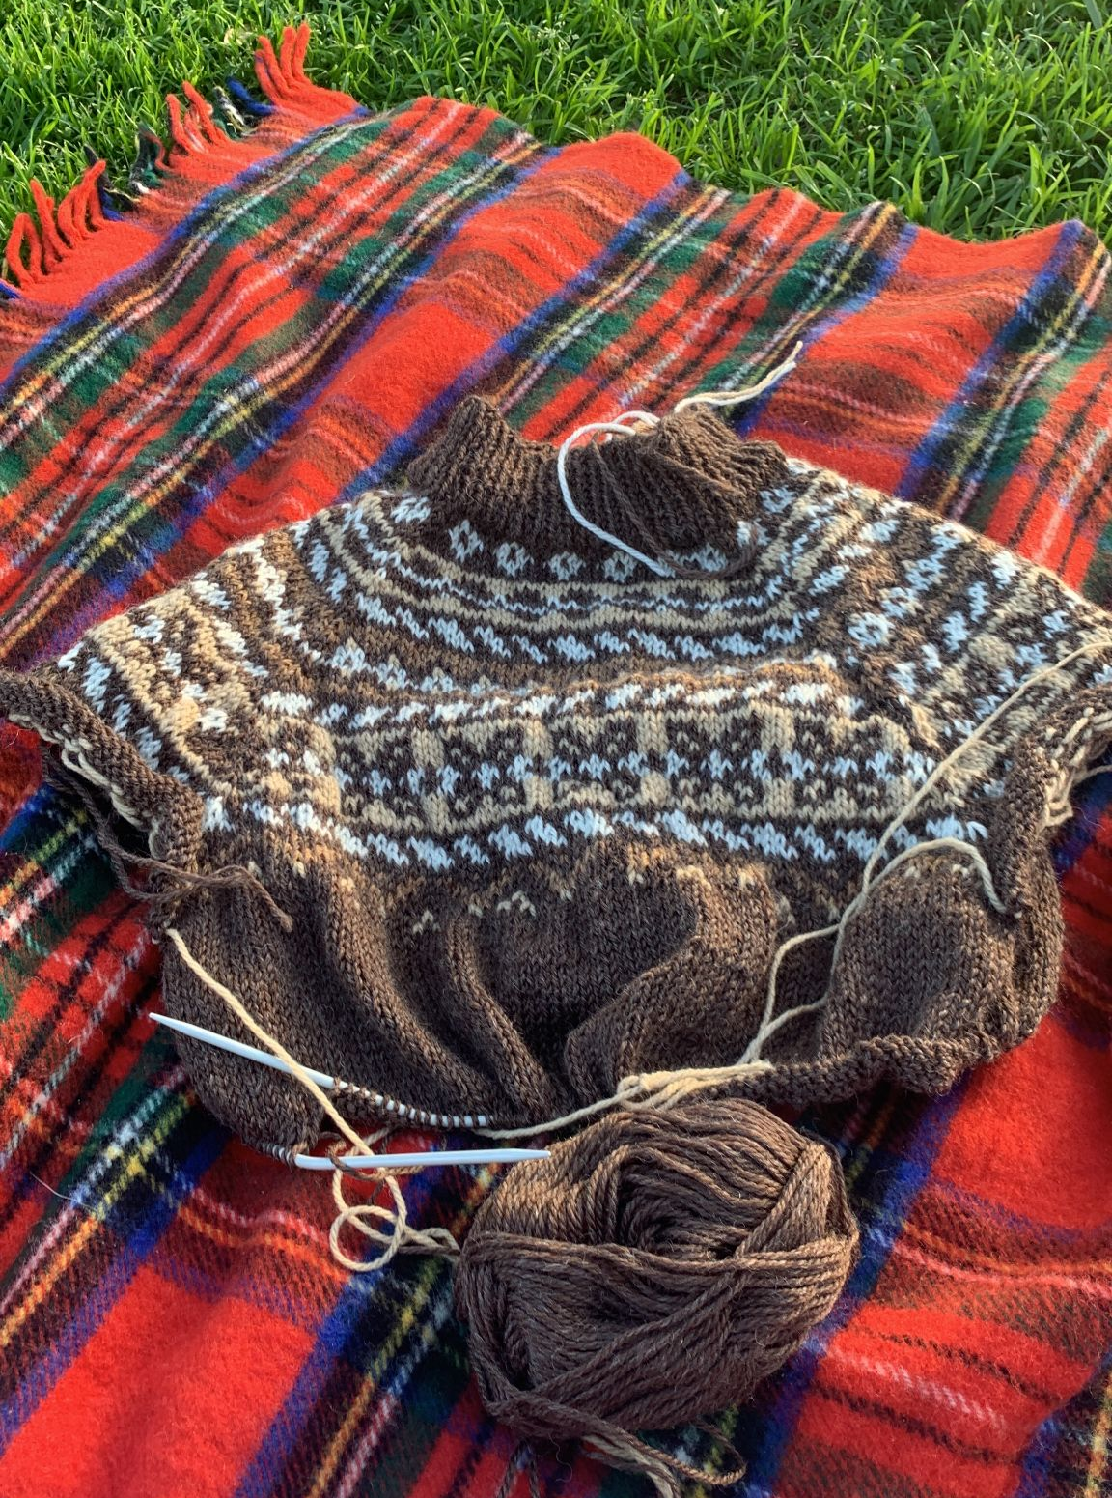
A little bit about me!
Took COMP10001 in 2016
Graduated BSc in 2018
Graduated Master of Computational Biology in 2020
Now working on a PhD in the School of Maths and Stats
Geospatial modelling of mosquito-borne diseases:
Zoonotic malaria, drug-resistant malaria, Japanese encephalitis
Structured spatial decision making:
Where should we concentrate resources given the things we know about disease risk?

Slide 7
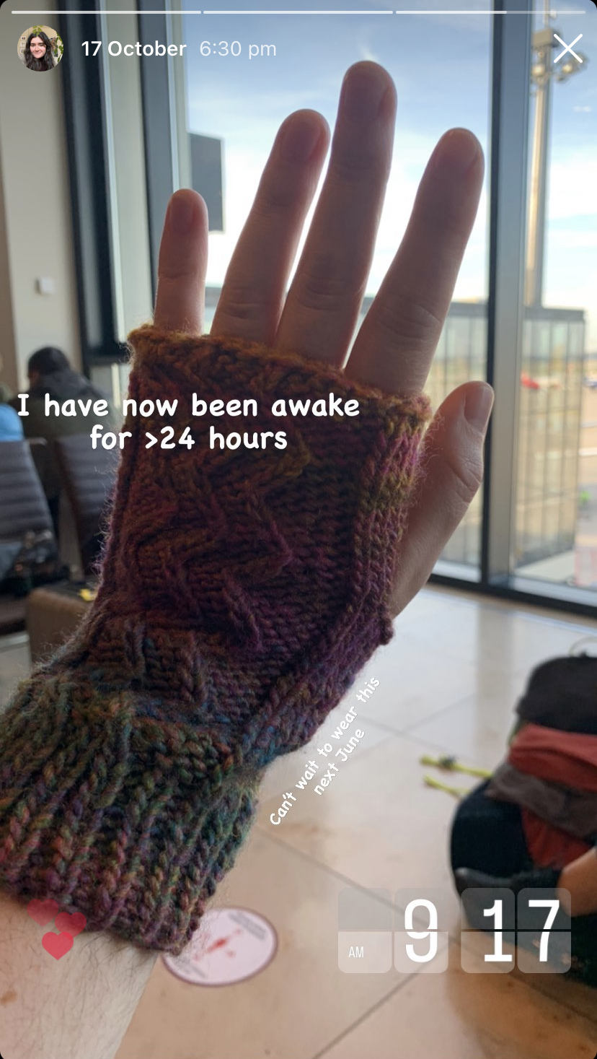
A little bit about me!
Took COMP10001 in 2016
Graduated BSc in 2018
Graduated Master of Computational Biology in 2020
Now working on a PhD in the School of Maths and Stats
Geospatial modelling of mosquito-borne diseases:
Zoonotic malaria, drug-resistant malaria, Japanese encephalitis
Structured spatial decision making:
Where should we concentrate resources given the things we know about disease risk?

Slide 8
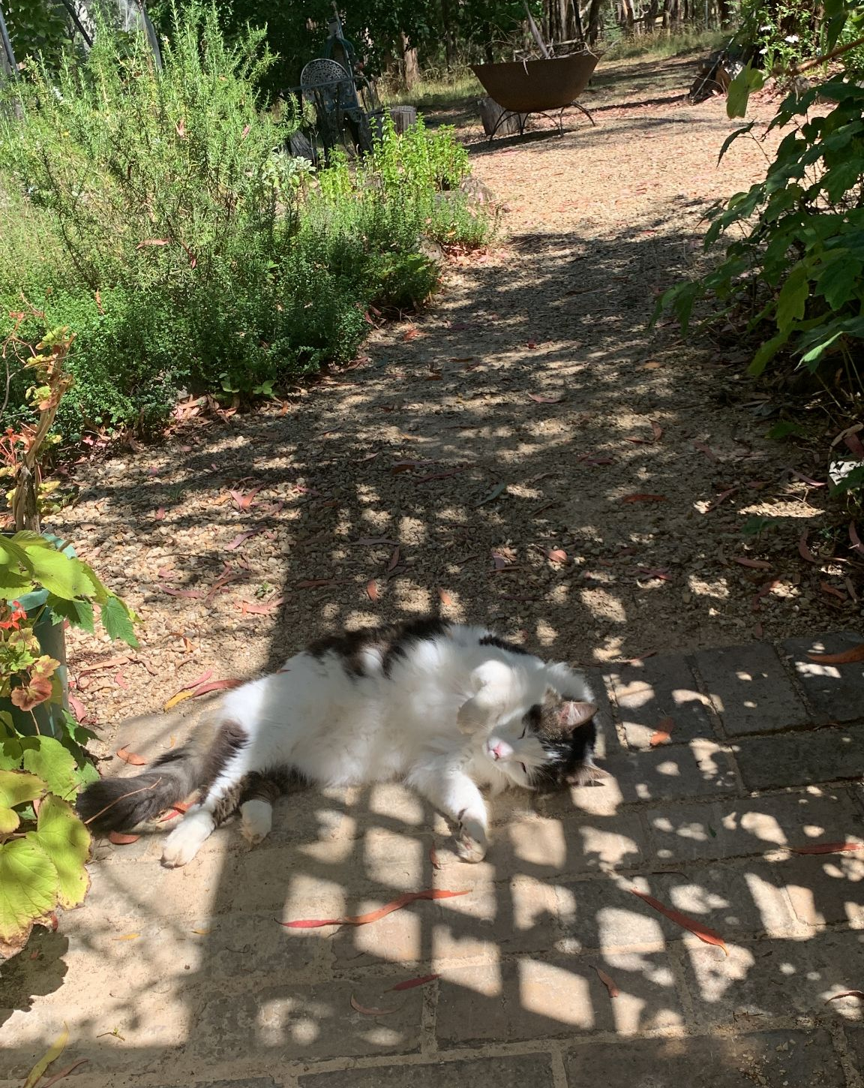
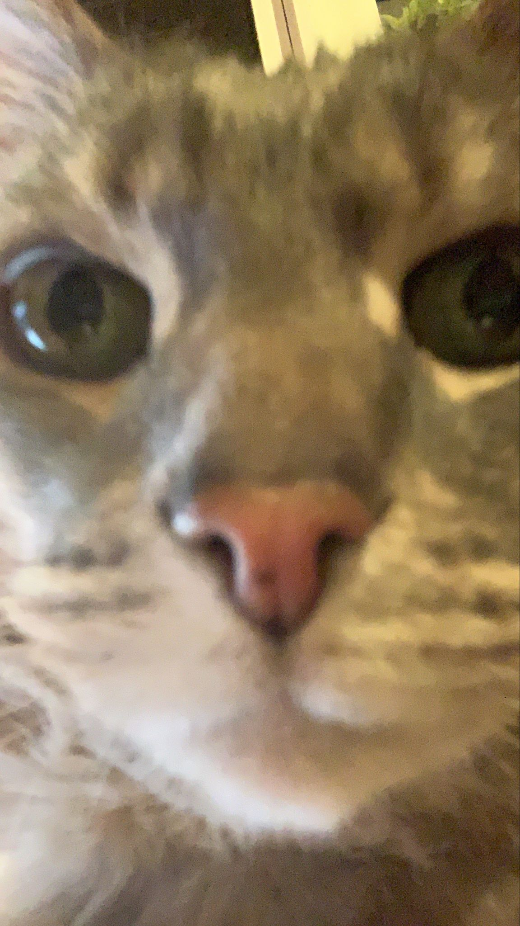
A little bit about me!
Took COMP10001 in 2016
Graduated BSc in 2018
Graduated Master of Computational Biology in 2020
Now working on a PhD in the School of Maths and Stats
Geospatial modelling of mosquito-borne diseases:
Zoonotic malaria, drug-resistant malaria, Japanese encephalitis
Structured spatial decision making:
Where should we concentrate resources given the things we know about disease risk?

Slide 9
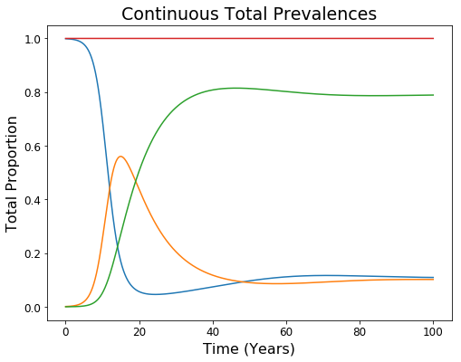
What do I love about computing?

Slide 10
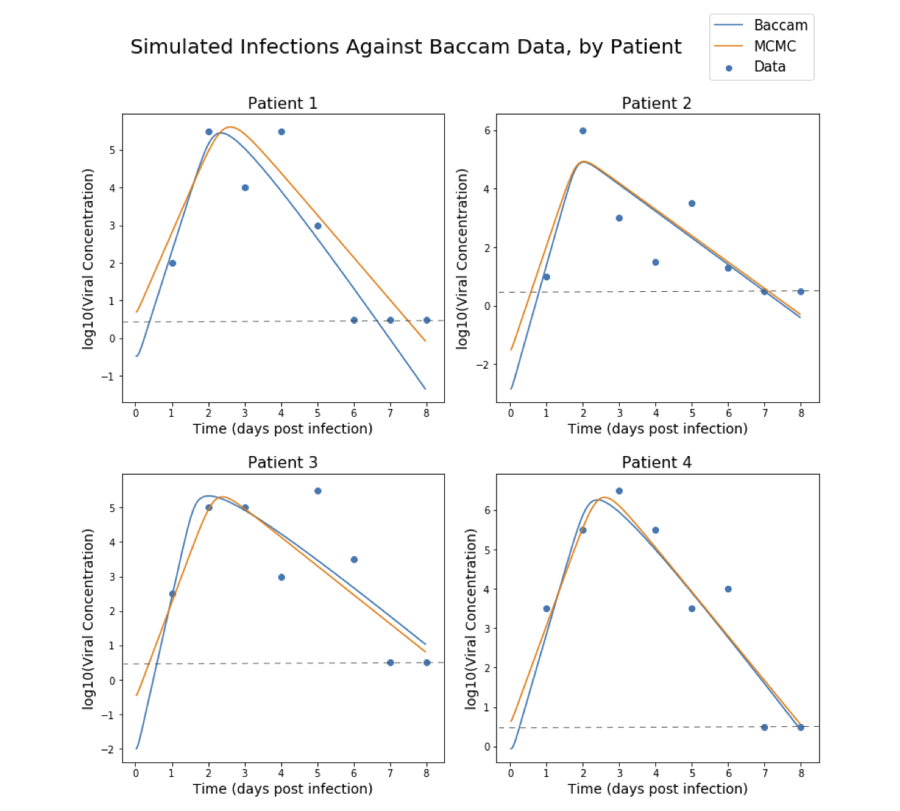
What do I love about computing?

Slide 11
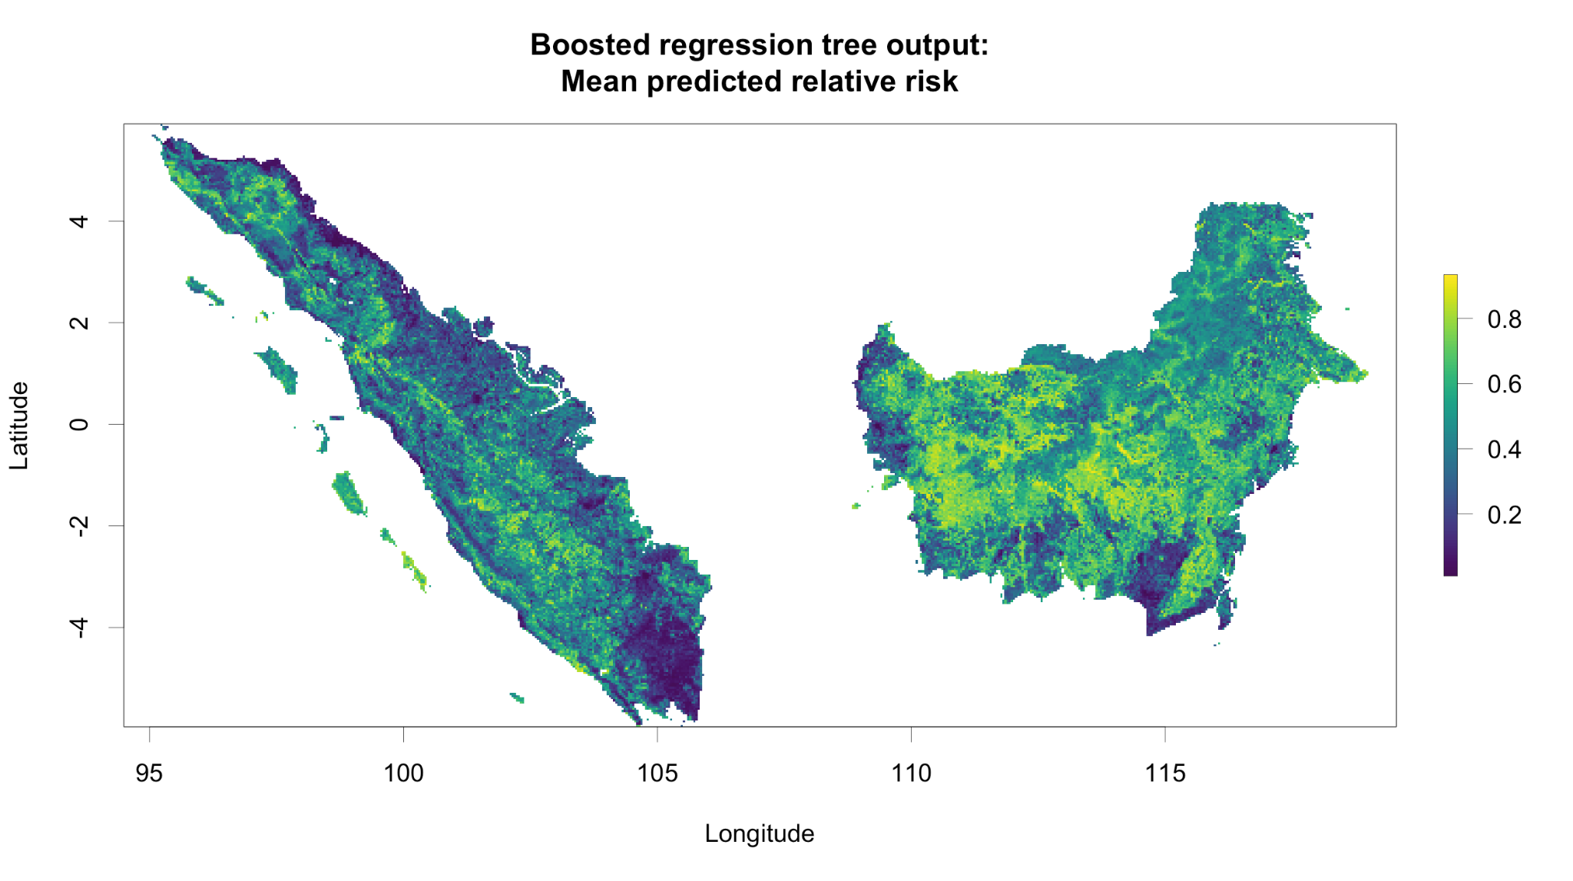

Slide 12
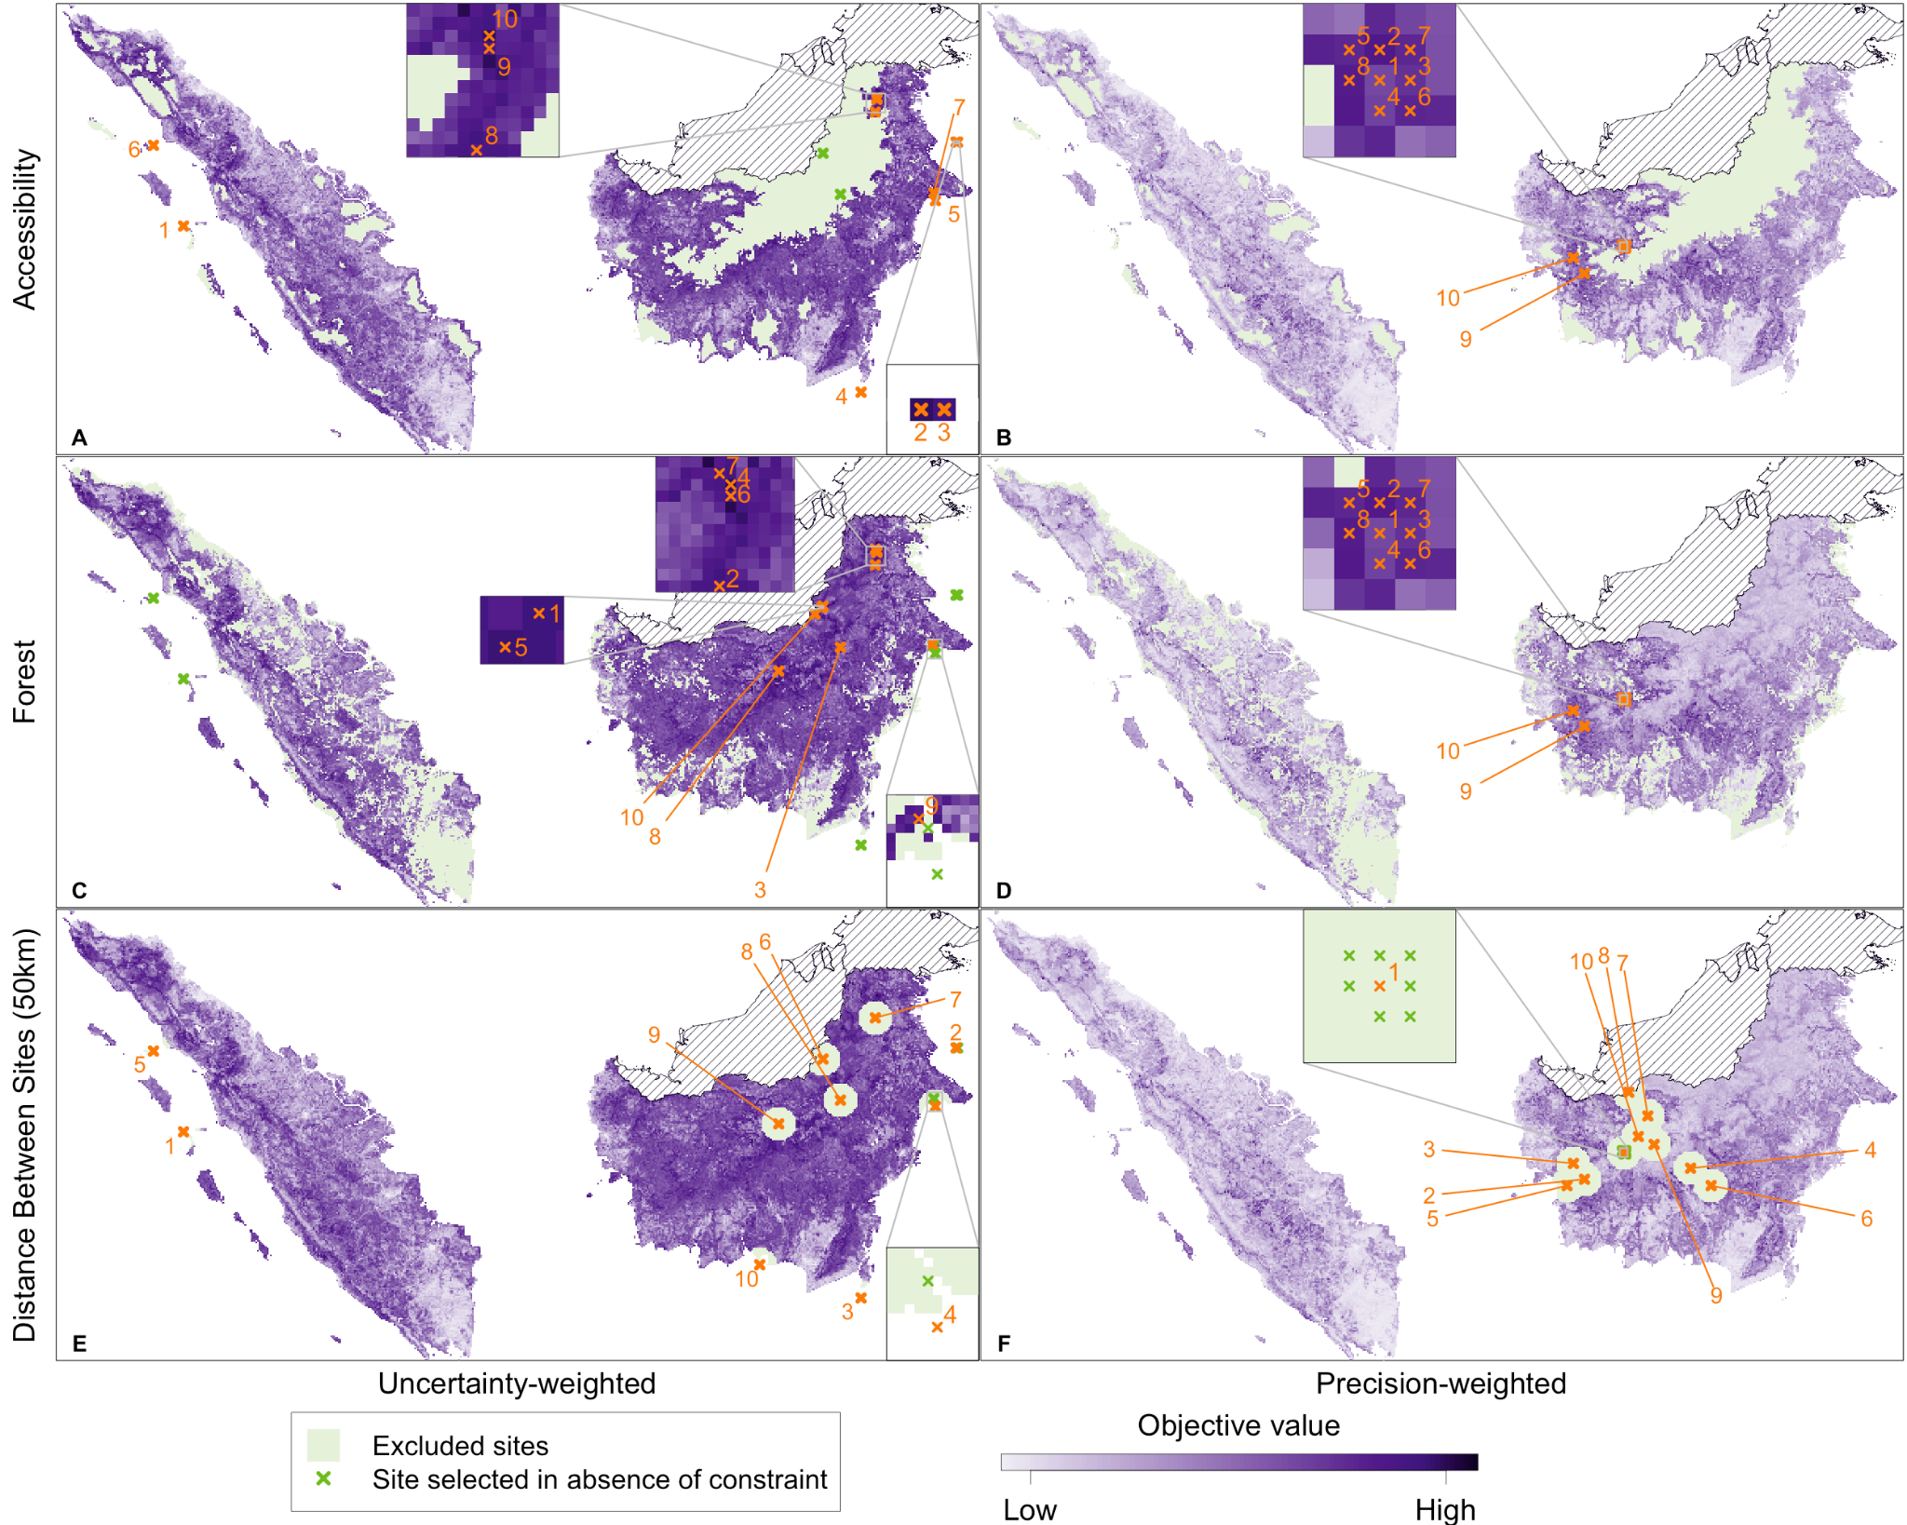

Slide 13
Who’s in the class?
Where are you from?

Slide 14
Who’s in the class?
Where are you from?
What’s your major?

Slide 15
Who’s in the class?
Where are you from?
What’s your major?
How long have you been at uni?

Slide 16
Who’s in the class?
Where are you from?
What’s your major?
How long have you been at uni?
Have you ever done any computing before?

Slide 17
My advice for COMP10001
Keep up to date with Grok!

Slide 18
My advice for COMP10001
Keep up to date with Grok!
If you need help, ask for it early!
Second tutorial hour
First year computing centre, level 3 Melbourne Connect
Subject forum
Grok tutor messaging
lucy.harrison@unimelb.edu.au

Slide 19
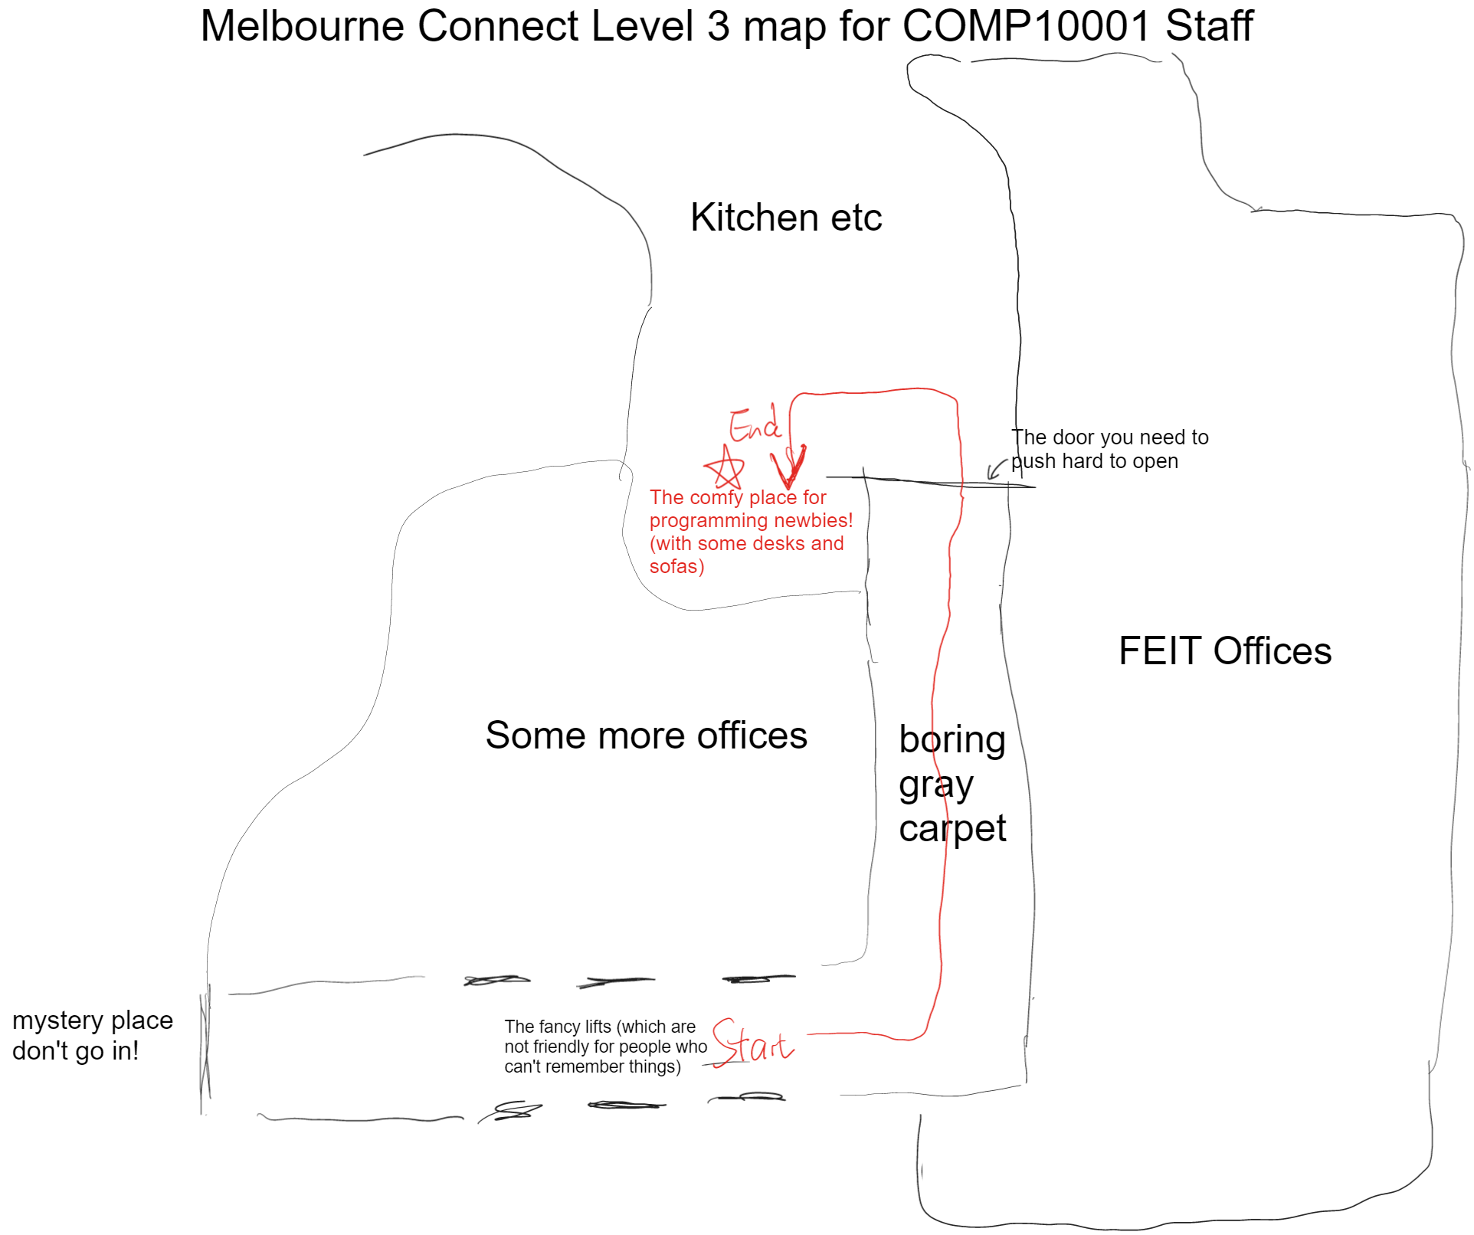
My advice for COMP10001
Level 3!
Keep up to date with Grok!
If you need help, ask for it early!
Second tutorial hour
First year computing centre, level 3 Melbourne Connect
Subject forum
Grok tutor messaging
lucy.harrison@unimelb.edu.au

Slide 20
First question!
What’s a program?

Slide 21
First question!
What’s a program?
How do we write a program?

Slide 22
First question!
What’s a program?
How do we write a program?
What does it mean to run a program?

Slide 23
Second question!
What is a programming language?

Slide 24
Second question!
What is a programming language?
Why do we need programming languages?

Slide 25
And that’s it!

